Slide 1
Software Product Revenue
Prof. Dr. Dirk Riehle
Friedrich-Alexander University Erlangen-Nürnberg
PROD B02
Licensed under CC BY 4.0 International
Notes:
It is Friedrich-Alexander University Erlangen-Nürnberg – FAU, in short.
Corporate identity wants us to say “Friedrich-Alexander University”.

Slide 2
Software Product Revenue (Recap)
one-time license sale
revenue
initial
one-time
license fee
annual maintenance fee (~20% of initial fee)
1
2
3
4
5
time

Slide 3
Core, Basic, and Whole Product (Recap)
Core product =
  Core software
Basic product = bundle of
  Software + complementary materials + self-help services
  Guarantees about fitness for use + indemnification
  Support services
Whole product = basic product +
  Training
  Consulting
  Operations

Slide 4
Whole product
Basic product
Usage rights
Software (core product)
Core software
Additional software (extensions + plug-
ins, tools and utiltiies, integrations)
Complementary materials
Documentation
Training materials
Self-help services
Forums, mailing lists
Help and chat agents
On-line tutorials
Pricing of usage rights
Quantity: User, machine, time, …
Duration: Perpetual, time-limited, …
Structured: Initial license fee, regular maintenance fee
Guarantees (“insurance”)
Fitness for use, certification
Indemnification
Support services
Hot-line support
On-site servicing
Pricing of guarantees
By damage: Loss of business, fines received
Structured: Levels / bands, formula
Pricing of support services (SLAs)
By availability: Incident-based, 9x5, 24x7
By quality: First-level, second-level, third-level
Training
In-house training
Off-site training
Consulting
Technical implementation services
Strategic solution consulting
Operations
Provision of SaaS (managed service)
Pricing of training
Fixed fee
Per participating person
Pricing of consulting
Fixed fee
Time and materials
Pricing of operations
Quantity: Users, resources, …
Duration: Always time-limited
Structured: Set-up, subscription

Slide 5
Four Example Products
Spotify
Hootsuite
On premise vs. Cloud
Tetris
Renderman
Enterprise vs. Retail Customers

Slide 6
Basic Product
A bundle of three contractually agreed-upon provisions
  Usage rights to software, complementary materials, and self-help services
  Guarantees about fitness for use and indemnification
  Support services

Slide 7
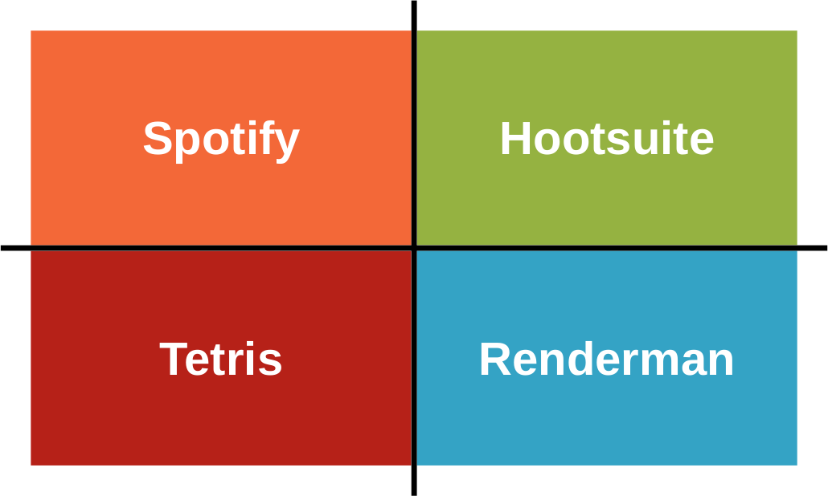
(Usage Rights to) Software
Core software
Additional software
  Extensions and plug-ins
  Tools and utilities
  Integrations with other software

Slide 8
(Usage Rights to) Complementary Materials
Documentation
Training materials

Slide 9
(Usage Rights to) Self-help Services
Forums and mailing lists
Chat and help agents
On-line training

Slide 10
Pricing of Usage Rights
By consumption
  Number of users
  Number of cores / processors / machines
  Amount of time consumed
By availability
  Perpetual
  Time-limited (e.g. one year)
  Only on Halloween at 6:66am
Structured as
  Initial license fee
  Regular maintenance fee
  Prepaid, postpaid, some other time

Slide 11
Guarantees
General fitness for use
Certification / certified fitness for use
Indemnification from damages

Slide 12
(Guarantee of) Fitness for Use
Fitness for use is
  The fitness of the product for described uses
In case of unfitness, vendor typically has (right) to fix problem
  Provides bug fixes within defined time
In case of continued unfitness
  Loss of business may have to be compensated

Slide 13
The Meaning of “Maintenance”
Maintenance
  Is the provision of bug fixes to customers
  Pro-actively or in response to bug reports
Vendors will try to sell maintenance as a positive feature
  Legally speaking, they are making good on “fitness for use”
  This is a smart move to hide problems, but legally questionable

Slide 14
Certification
Certification
  Is a guarantee of fitness for use
    for a formally defined domain / use
  Is provided by a
    Certification agency
    Complementary product vendor
Is often a purchase requirement

Slide 15
Indemnification
Indemnification (“Schadensfreistellung”) is
  The vendor’s guarantee to compensate customer for any damages
If customer (C) gets sued by their customers (U)
  The vendor (V) may have to compensate customer for fines incurred
Sells indemnification
Provides service
V
C
U
Requests damages payment
Sues for damages

Slide 16
Pricing of Guarantees
Commensurate with damage incurred
  Lost business in case of unfitness for use
  Fines received in case of indemnification
Priced in levels or bands or using a formula

Slide 17
Support Services
Hot-line support
On-site servicing

Slide 18
Pricing of Support Services
By availability
  Incident-based, 9x5, 24x7, …
By quality
  First-level, second-level, third-level support

Slide 19
Training
In-house training
  Vendor holds training at customer location
Off-site training
  Users attend training at vendor location

Slide 20
Pricing of Training
Fixed fee
Per person
By volume

Slide 21
Consulting
Technical implementation services
Strategic solution consulting

Slide 22
Pricing of Consulting
Fixed fee
Time and materials

Slide 23
Operations
Provision of Software-as-a-Service

Slide 24
Pricing of Operations
Pricing is similar to usage rights
By consumption
  User, resources, time, …
Structured as
  Set-up free, subscription fee
Duration is always limited in time

Slide 25
Review / Summary of Session
Software products
  Core, basic, and whole product
The basic product
  Usage rights, guarantees, and support services
The whole product
  Training, consulting, and operations
Dimensions of pricing

Slide 26
Thank you! Questions?
dirk.riehle@fau.de – http://osr.cs.fau.de
dirk@riehle.org – http://dirkriehle.com – @dirkriehle
DR

Slide 27
Credits and License
Original version
  © 2012-2018 Dirk Riehle, some rights reserved
  Licensed under the Creative Commons Attribution 4.0 International License
Contributions
  ...

